Slide 1
Quantum Error Correction
Rajesh Sathya Kumar

Slide 2
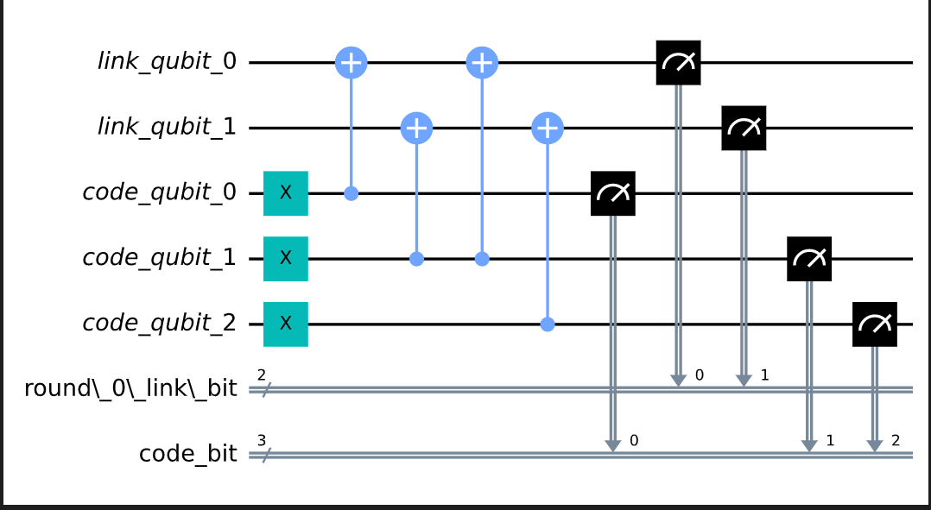
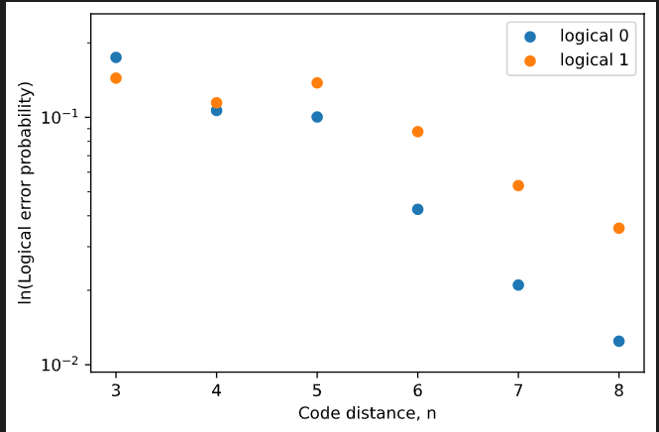
Current work
Avg Creation time, execution time, CLOPS, Circuit Depth, Volumetric Benchmarking
Implementation of error correction codes in Qiskit via repetition code

Slide 3
Next Steps 1. Check and implement on other error correction methods 2. Using QML Methods to improve error correction
References:
Quantum Error Mitigation With Artificial Neural Network, Changjun Kim, Kyungdeock Daniel Park, June-Koo Rhee, https://ieeexplore.ieee.org/document/9226505

